Slide 1

Customer Shopping Behavior Analysis
This project analyzes 3,900 customer purchases to uncover spending patterns, product preferences, and subscription behavior, guiding strategic business decisions.

Slide 2



Project Overview & Dataset Summary
Project Goal
Uncover insights into spending patterns, customer segments, product preferences, and subscription behavior.
Dataset Size
3,900 rows, 18 columns of transactional data.
Key Features
Demographics, purchase details, shopping behavior, and subscription status.
Missing Data
37 values in the "Review Rating" column.

Slide 3

Exploratory Data Analysis (Python)
Data Preparation
Feature Engineering
Loaded dataset with pandas.
Created age_group by binning customer ages.
Explored structure with df.info() and .describe().
Derived purchase_frequency_days.
Imputed missing "Review Rating" values using median per category.
Dropped redundant promo_code_used column.
Loaded cleaned data into PostgreSQL for SQL analysis.
Renamed columns to snake_case for readability.

Slide 4
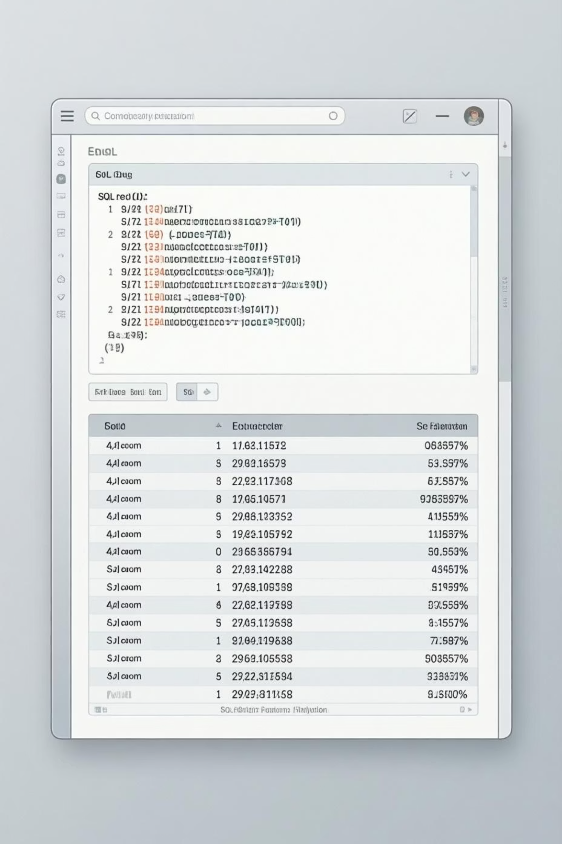



Data Analysis using SQL: Key Insights
Revenue by Gender
Top 5 Products by Rating
Male customers generated $157,890, Female $75,191.
Gloves (3.86), Sandals (3.84), Boots (3.82), Hat (3.80), Skirt (3.78).
Shipping Type
Express shipping has a higher average purchase amount ($60.48) than Standard ($58.46).

Slide 5

SQL Analysis: Discount & Subscription Behavior
High-Spending Discount Users
Subscribers vs. Non-Subscribers
Identified 839 customers who used discounts but spent above average.
Non-subscribers have higher total revenue ($170,436) and average spend ($59.87) compared to subscribers ($62,645 total, $59.49 avg).
Discount-Dependent Products
Hat (50%), Sneakers (49.66%), Coat (49.07%), Sweater (48.17%), Pants (47.37%) had highest discount usage.

Slide 6



Customer Segmentation & Loyalty
New
83 Customers
Loyal
3116 Customers
Returning
701 Customers
Customers were segmented into Loyal, New, and Returning based on purchase history.

Slide 7
Top Products by Category
1
Accessories
Jewelry
171
1
Clothing
Blouse
171
1
Footwear
Sandals
160
1
Outerwear
Jacket
163
This table highlights the most purchased items within each product category.

Slide 8
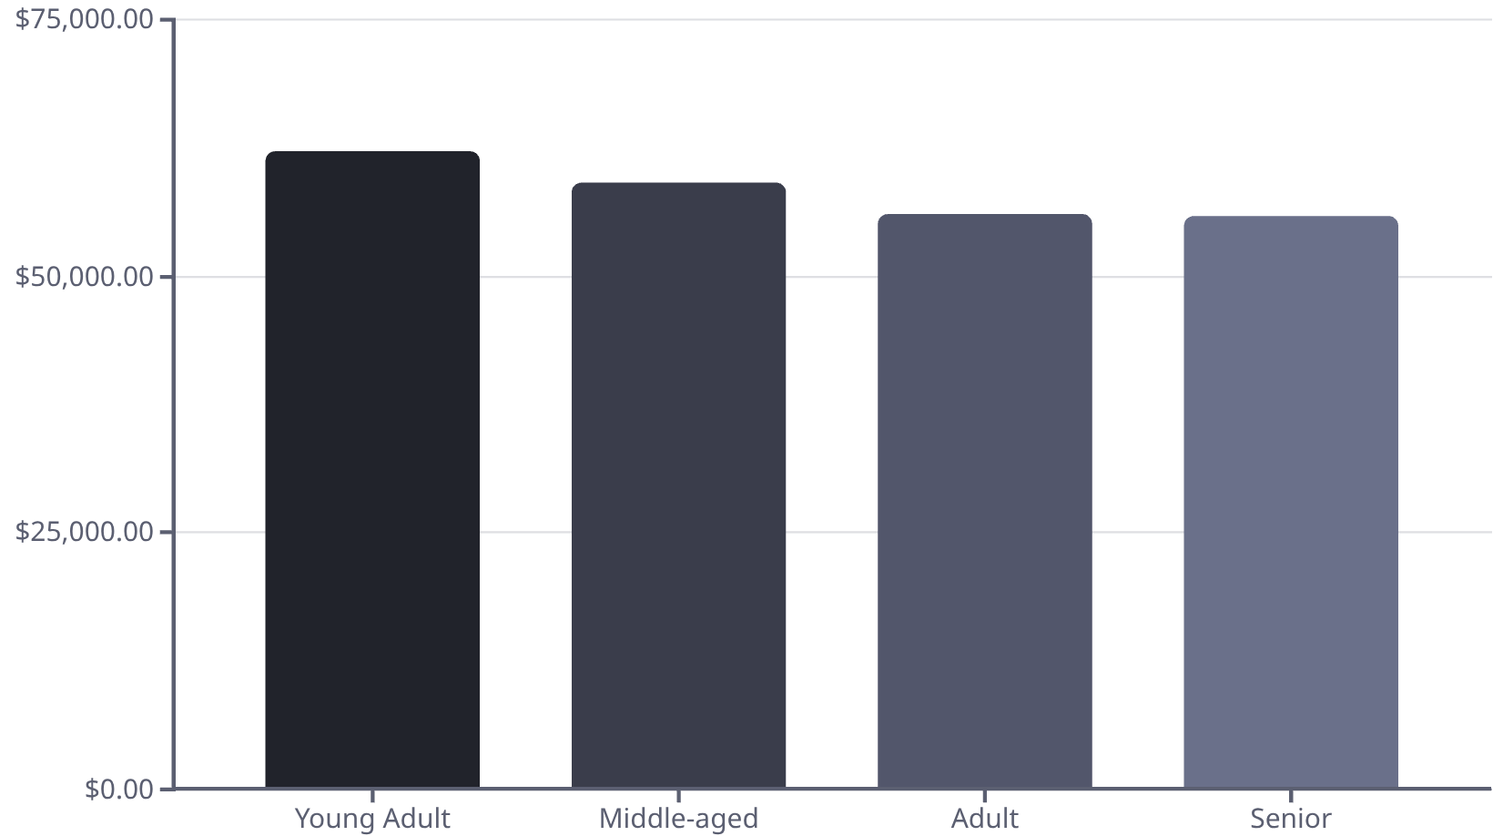
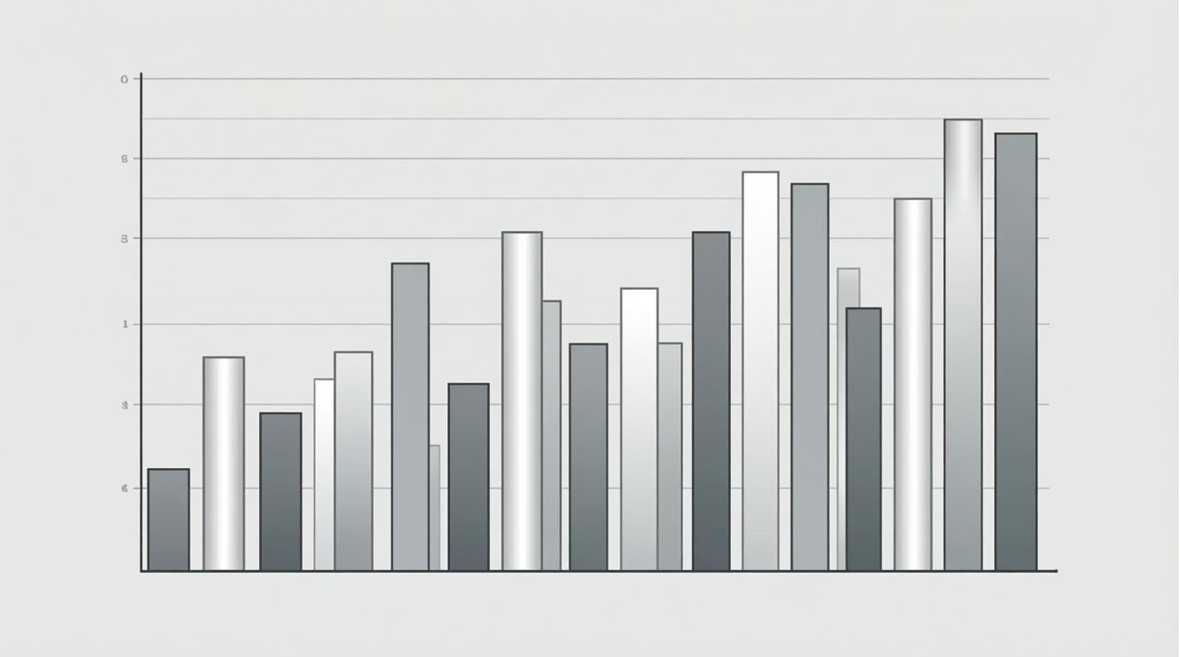
Age Group Revenue & Repeat Buyers
Revenue by Age Group
Repeat Buyers & Subscriptions
Customers with more than 5 purchases are more likely to subscribe (958 subscribers vs. 2518 non-subscribers).

Slide 9
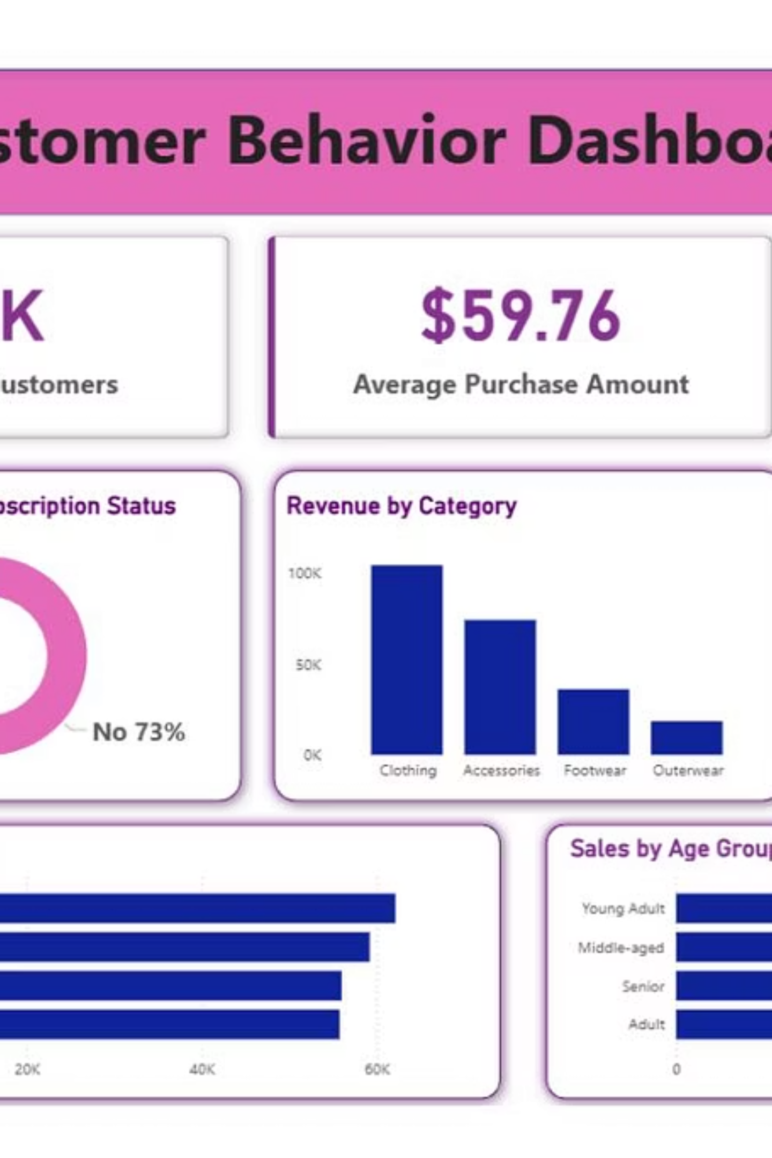
Interactive Dashboard in Power BI
An interactive dashboard was built in Power BI to visualize these insights, providing a dynamic tool for strategic decision-making.

Slide 10
Business Recommendations
Boost Subscriptions
Promote exclusive benefits to increase subscriber base.
Customer Loyalty
Reward repeat buyers to foster loyalty and move them to the "Loyal" segment.
Review Discount Policy
Optimize discounts to balance sales growth with profit margins.
Targeted Marketing
Focus campaigns on high-revenue age groups and express-shipping users.
Product Positioning
Highlight top-rated and best-selling products in marketing efforts.

